Slide 1

CLAIMS MANAGEMENT SYSTEM
OUR TEAM:
DHILEEP CHINNI​
DIPASHRI DESHMUKH​
CHARISHMA SHAIK​
DILEEP GAJULA

Slide 2
TABLE OF CONTENTS
PROBLEM STATEMENT
OVERVIEW
FEATURES
ARCHITECTURE
TECHNOLOGY
A CLOSER LOOK

Slide 3
PROBLEM STATEMENT

Slide 4

PROBLEM STATEMENT
A Leading HealthCare Management Organization wants to strengthen its middleware by exposing the core related logic related to Claims.
The middleware Microservices are to be hosted on Cloud.
Member Portal to be developed that consumes these Microservices and responds back to members who are in the need of Claim related information.

Slide 5
OVERVIEW

Slide 6
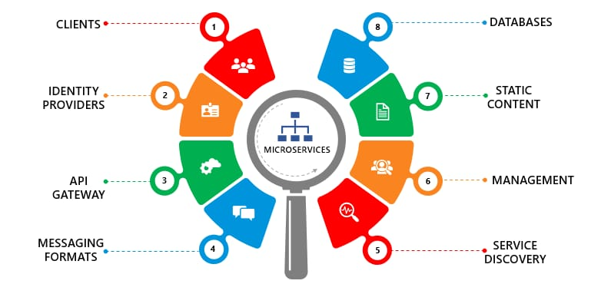
MICROSERVICES
The list of Microservices are:
1) AUTHORIZATION MICROSERVICE
2) MEMBER MICROSERVICE
3) CLAIMS MICROSERVICE
4) POLICY MICROSERVICE

Slide 7
FEATURES

Slide 8



FEATURES
The User can insert the Claim details like:
SUBMIT CLAIM: 1. ID
2. Hospital Name
3. Claim Amount
A Claim ID will be generated corresponding to the submitted claim.
CHECK STATUS: The User can check the status of a particular claim with the given claim ID. For instance, Claim is pending as more documents are needed for verification.
VIEW BILLS: The User can see if he/she has any pending bills along with the last premium paid date and late charges.

Slide 9
ARCHITECTURE

Slide 10
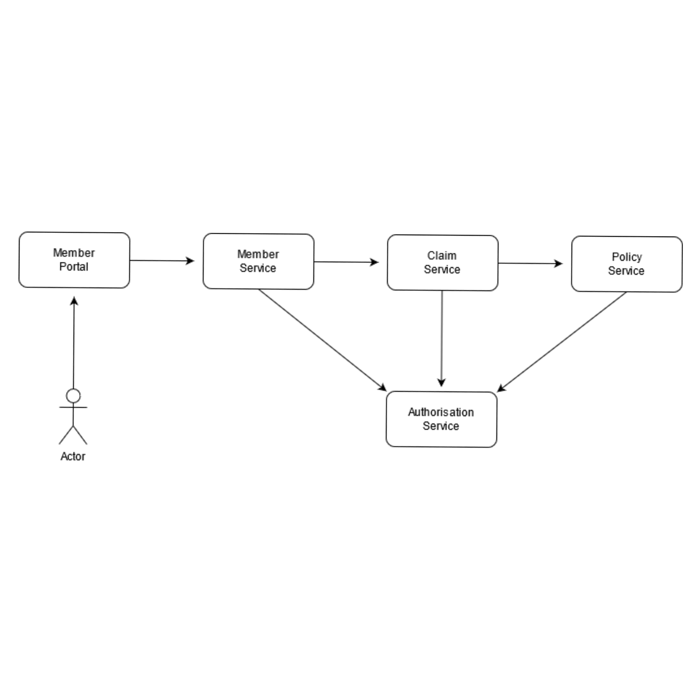
ARCHITECTURE/FLOW DIAGRAM

Slide 11
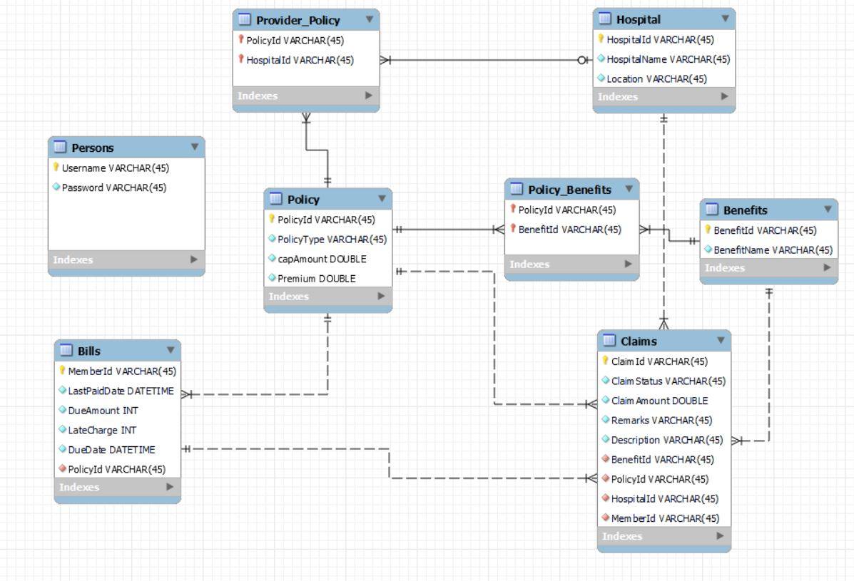
DATABASE SCHEMA

Slide 12
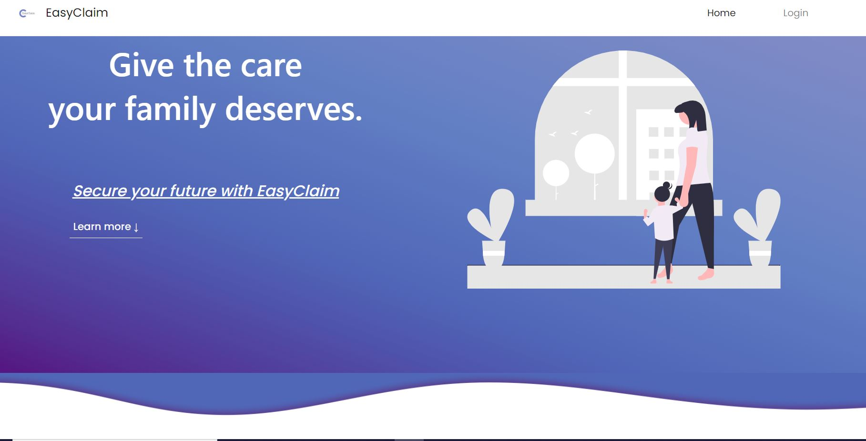
MEMBER PORTAL

Slide 13
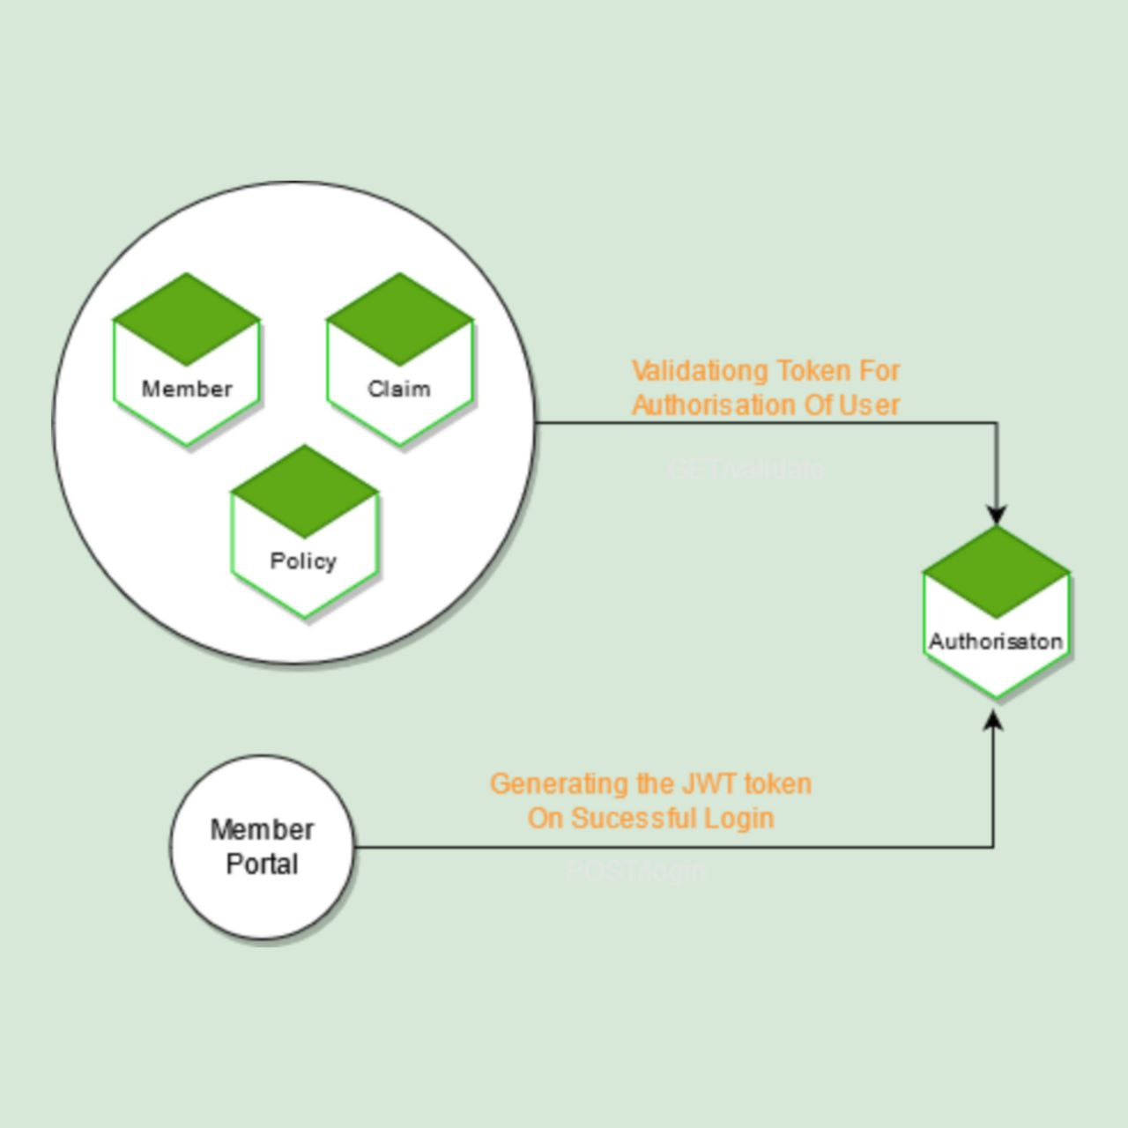
AUTHORIZATION MODULE

Slide 14
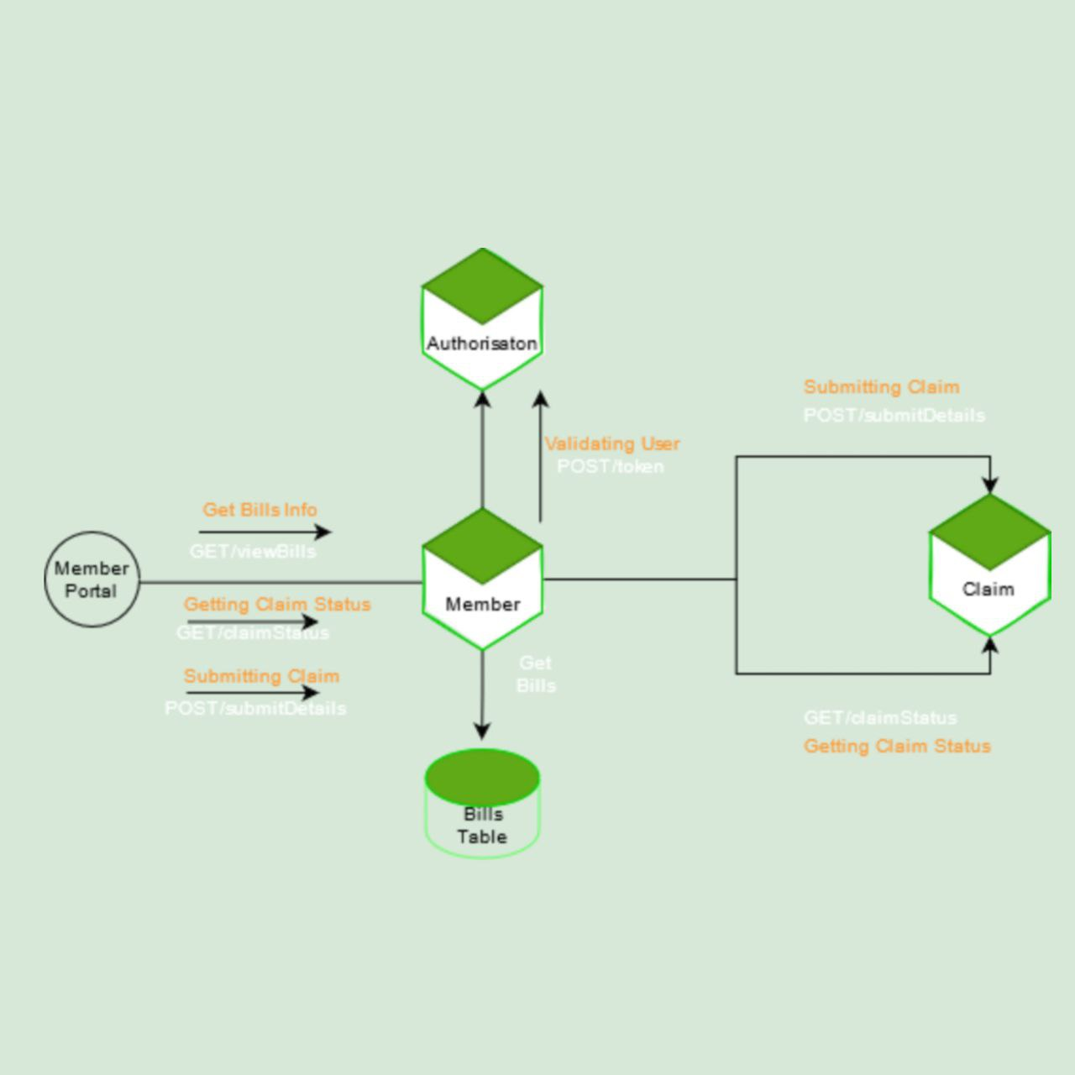
MEMBER MODULE

Slide 15
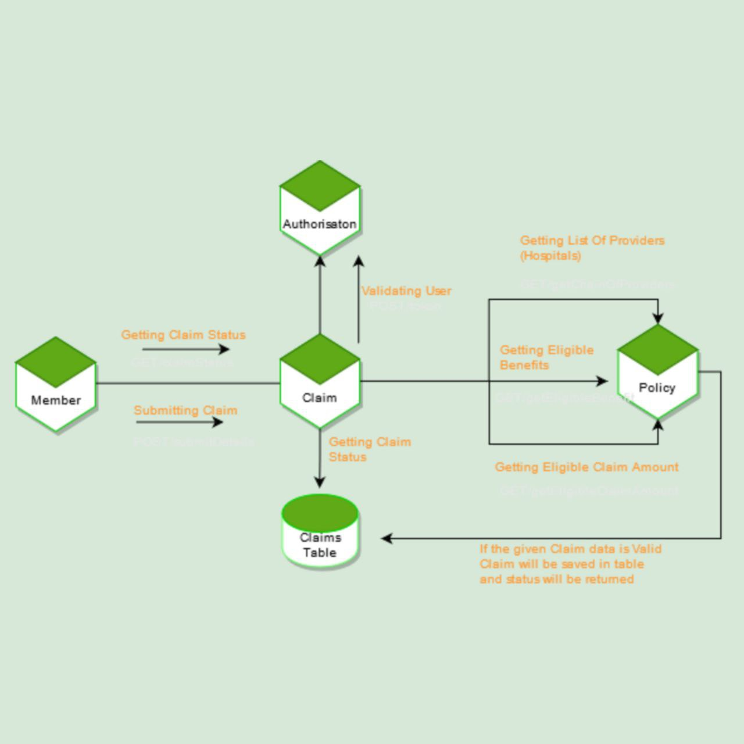
CLAIMS MODULE

Slide 16
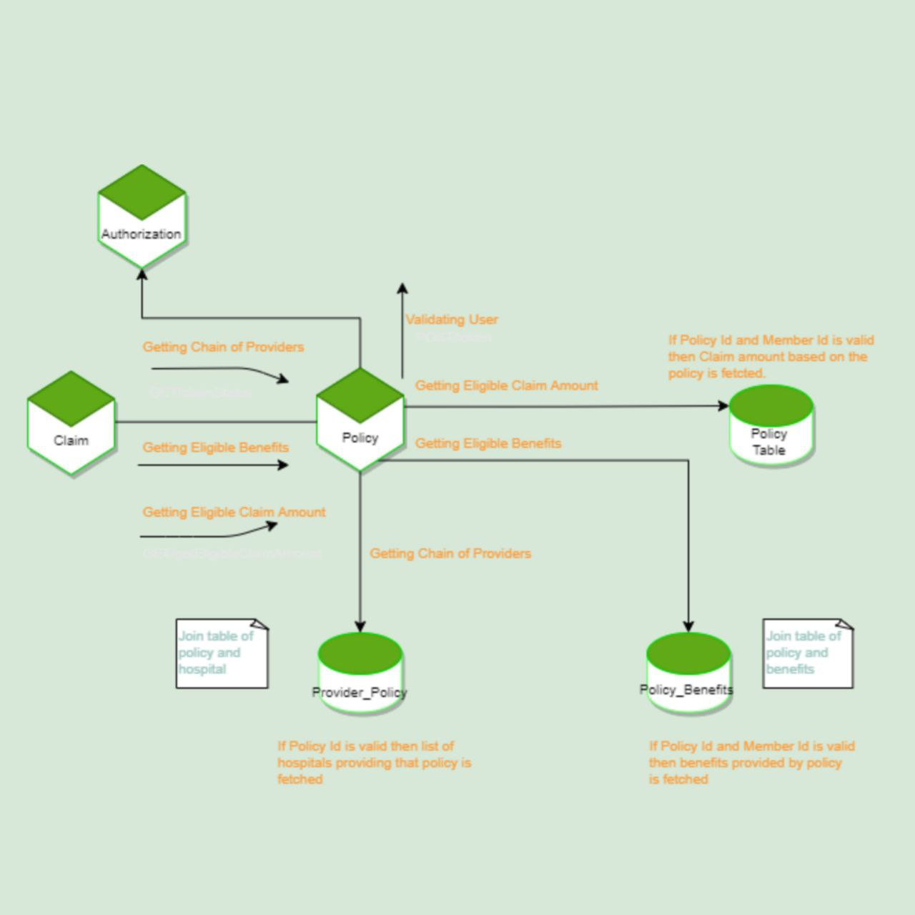
POLICY MODULE

Slide 17
TECHNOLOGY

Slide 18
TECHNOLOGY/FRAMEWORKS USED
FRONTEND – Angular,Bootstrap5
BACKEND – Spring MVC with Spring Boot
Spring Data JPA, H2 in Memory DB
TESTING – jUnit-4/jUnit-5
Mockito

Slide 19
DEVOPS & CLOUD – AWS CodeCommit
AWS EC2
AWS S3
ANCILLARY – Maven
Lombok
CODE QUALITY – SonarLint

Slide 20
A CLOSER LOOK

Slide 21
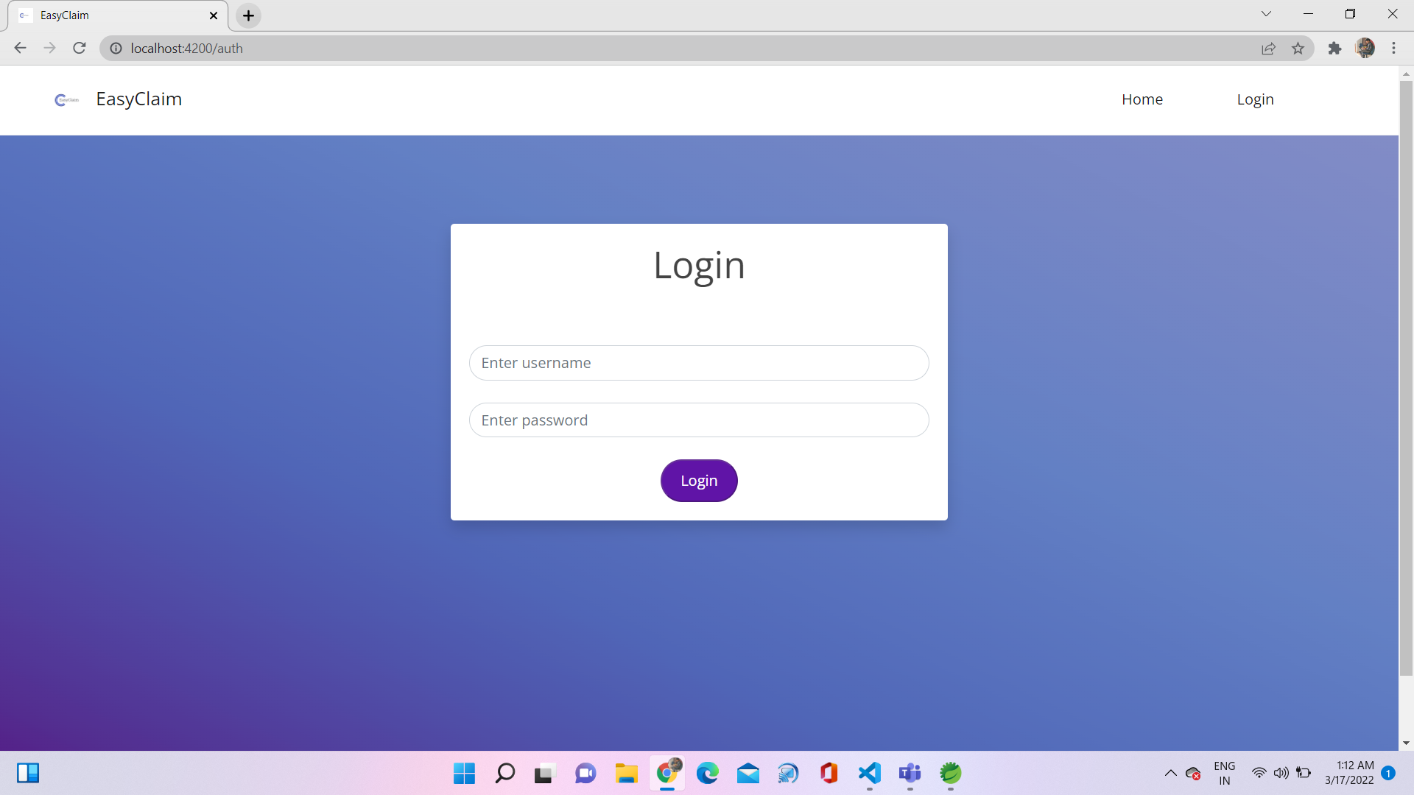

Slide 22
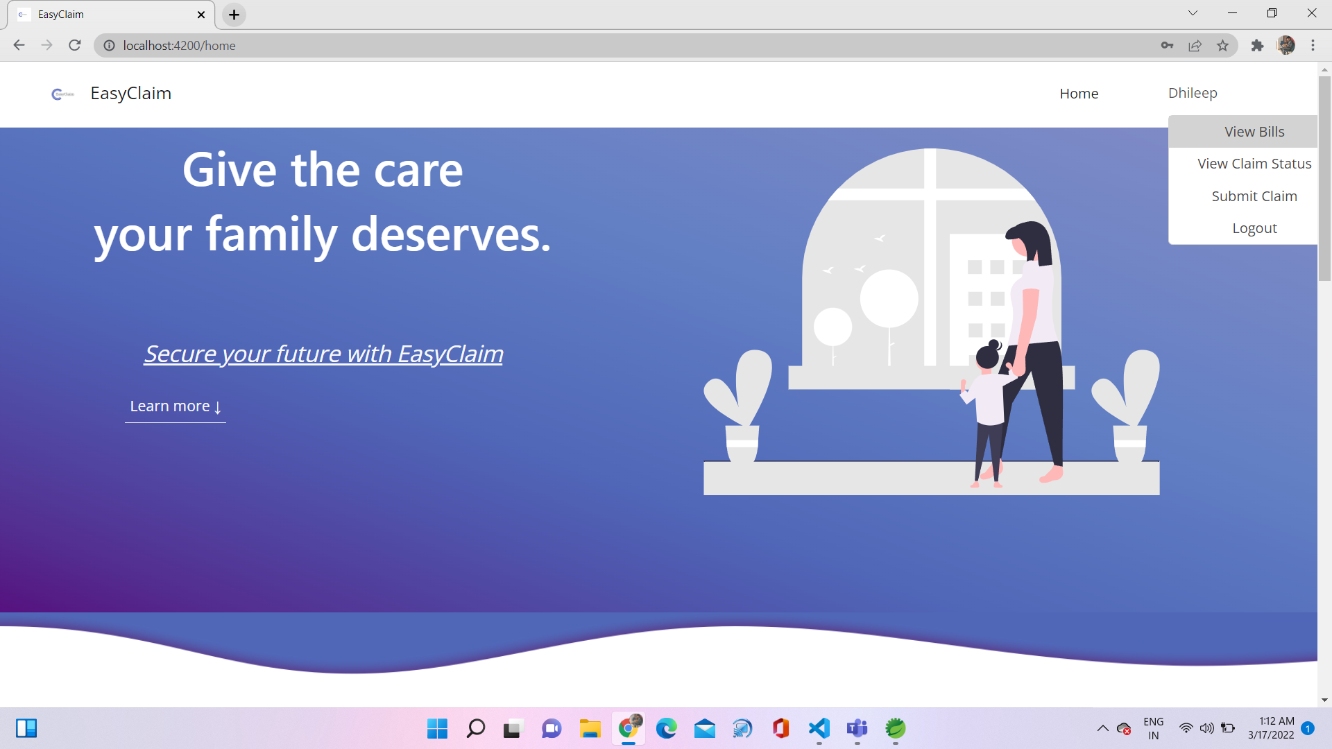

Slide 23
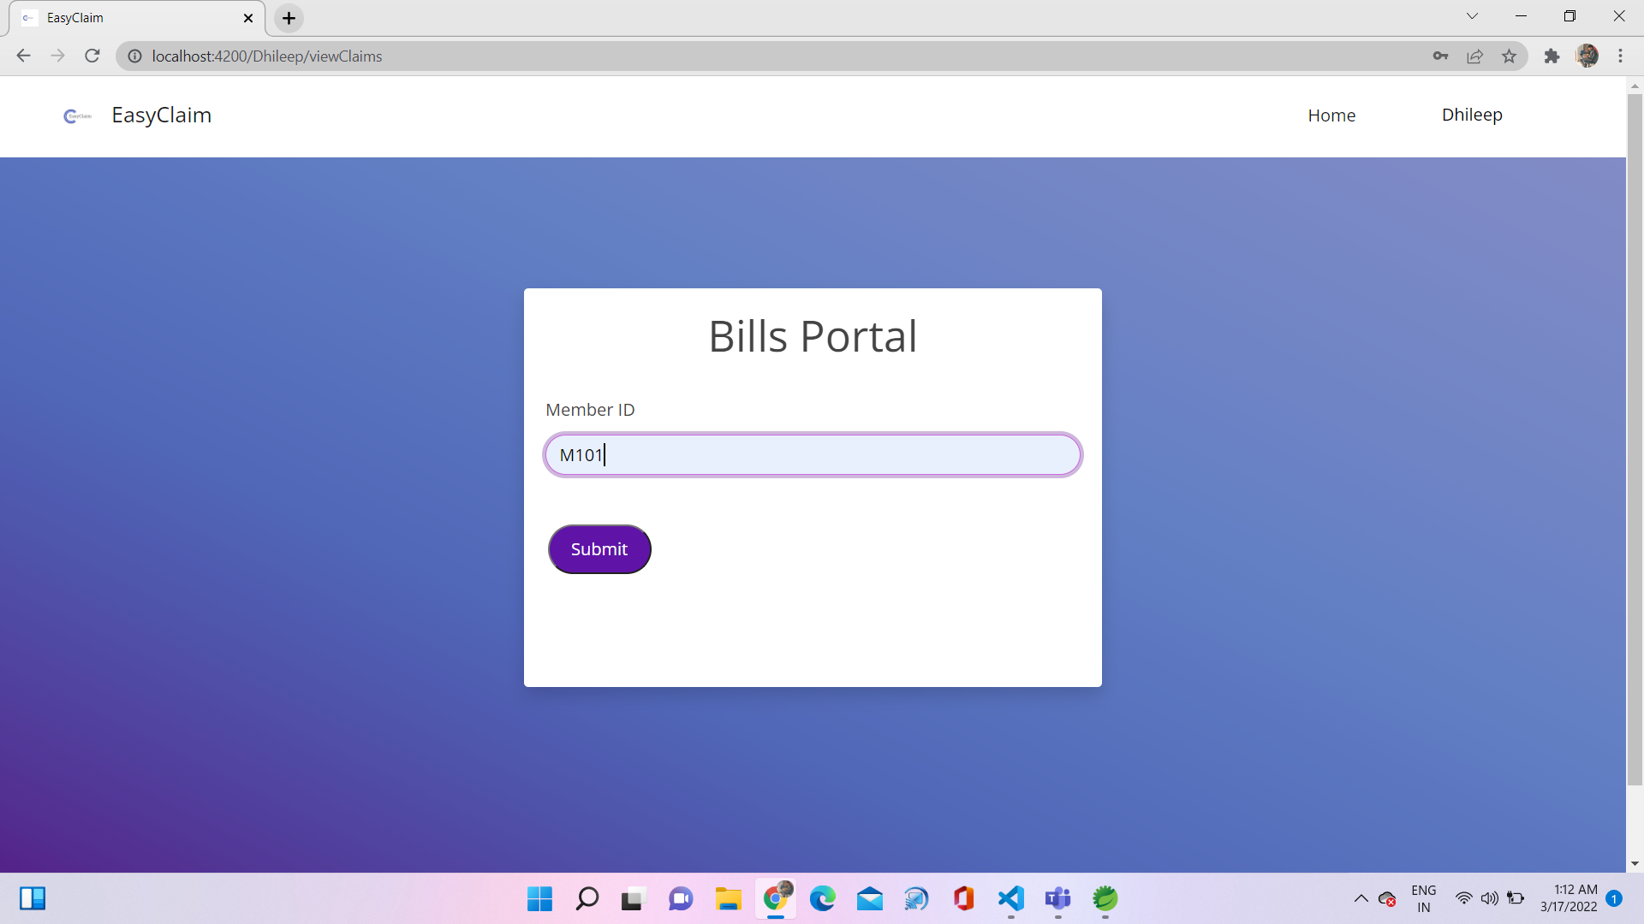

Slide 24
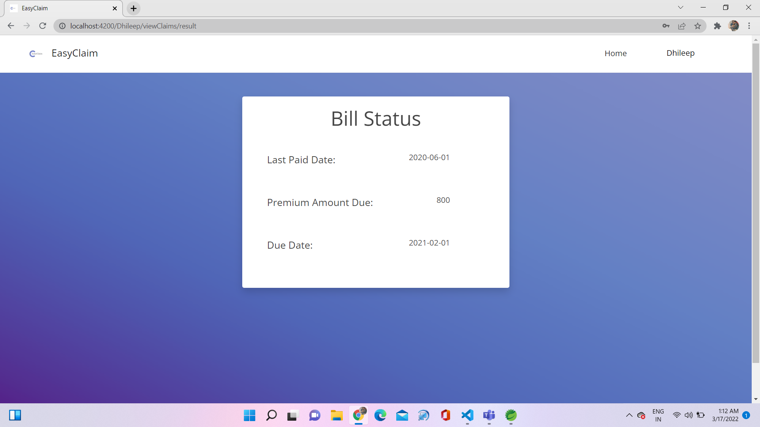

Slide 25
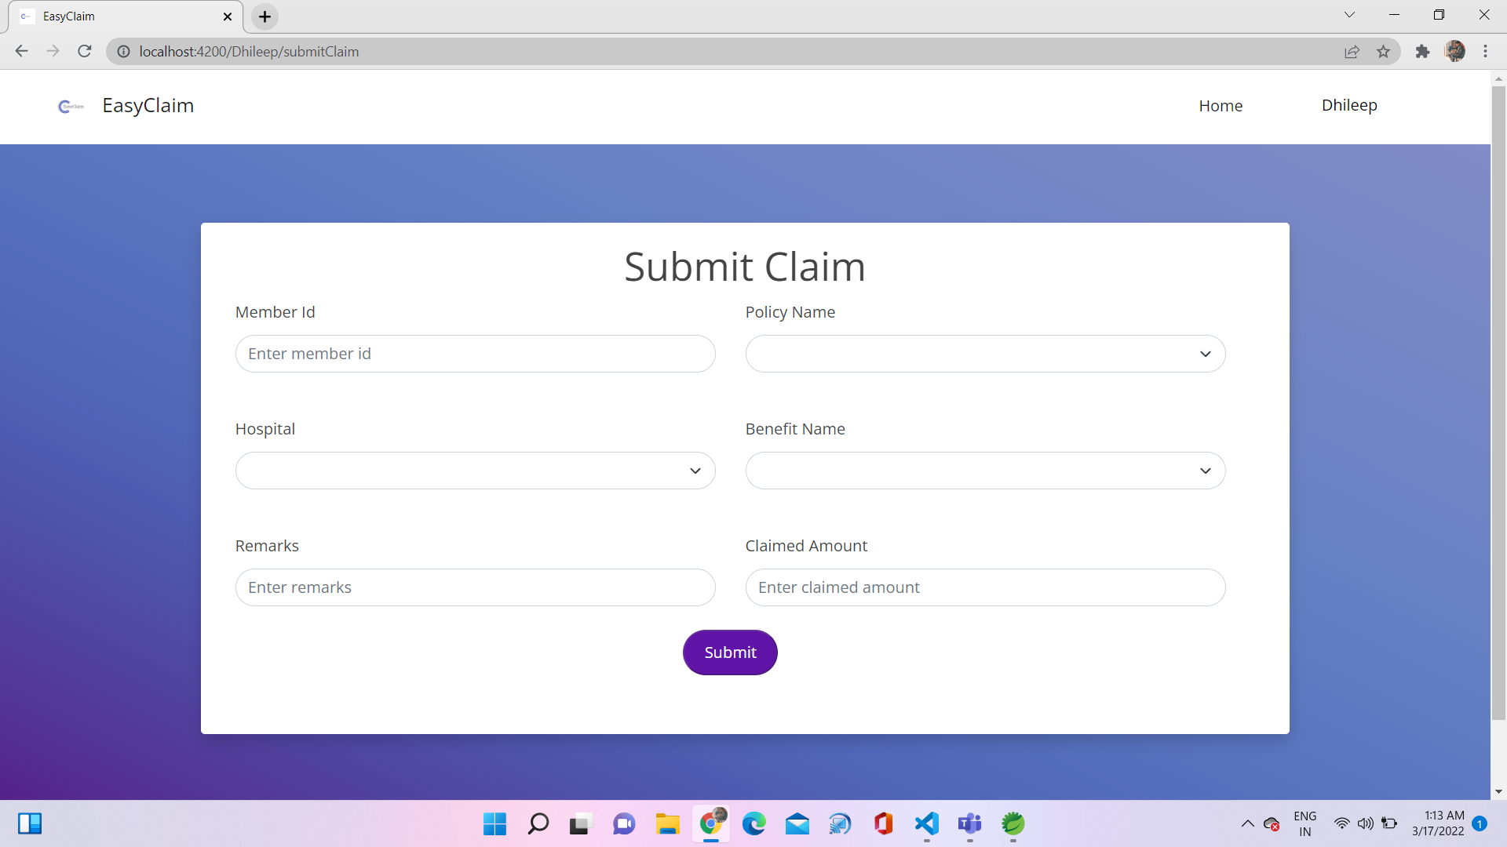

Slide 26
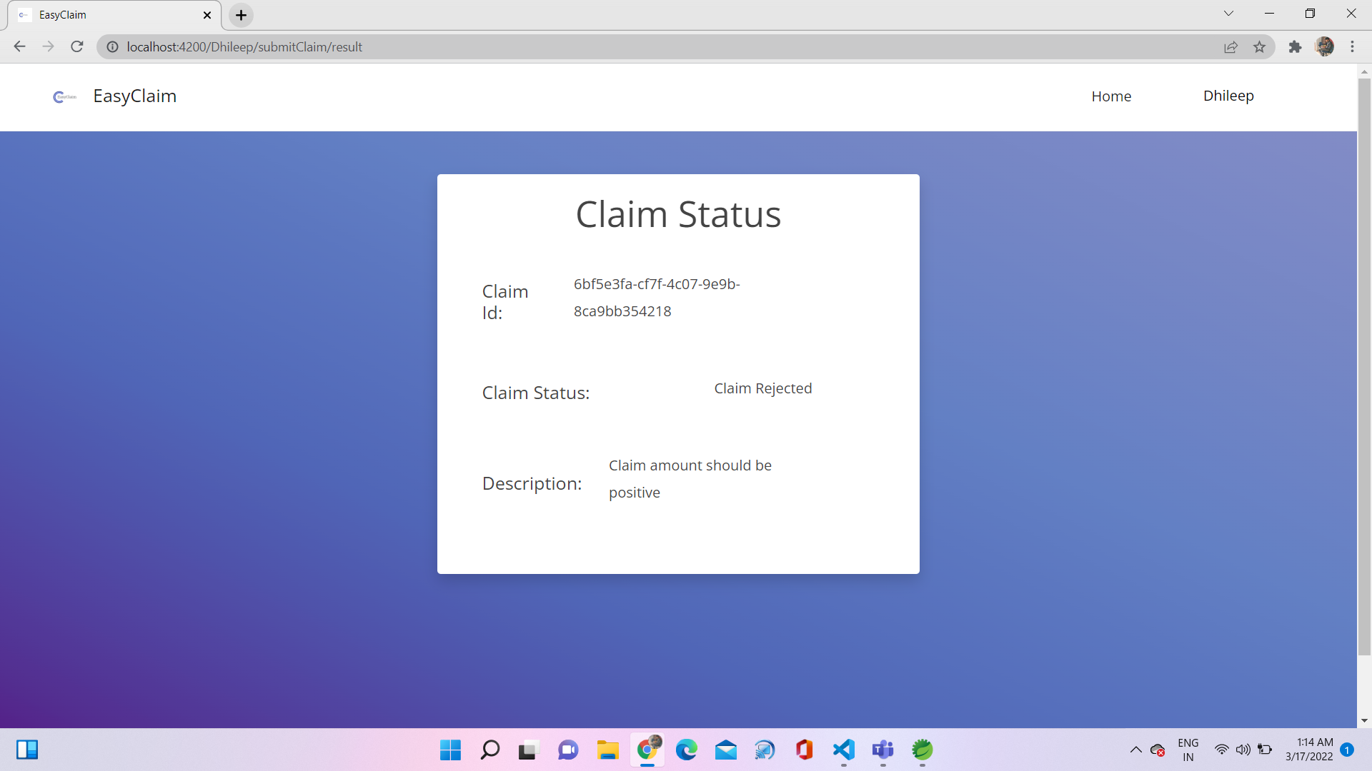

Slide 27
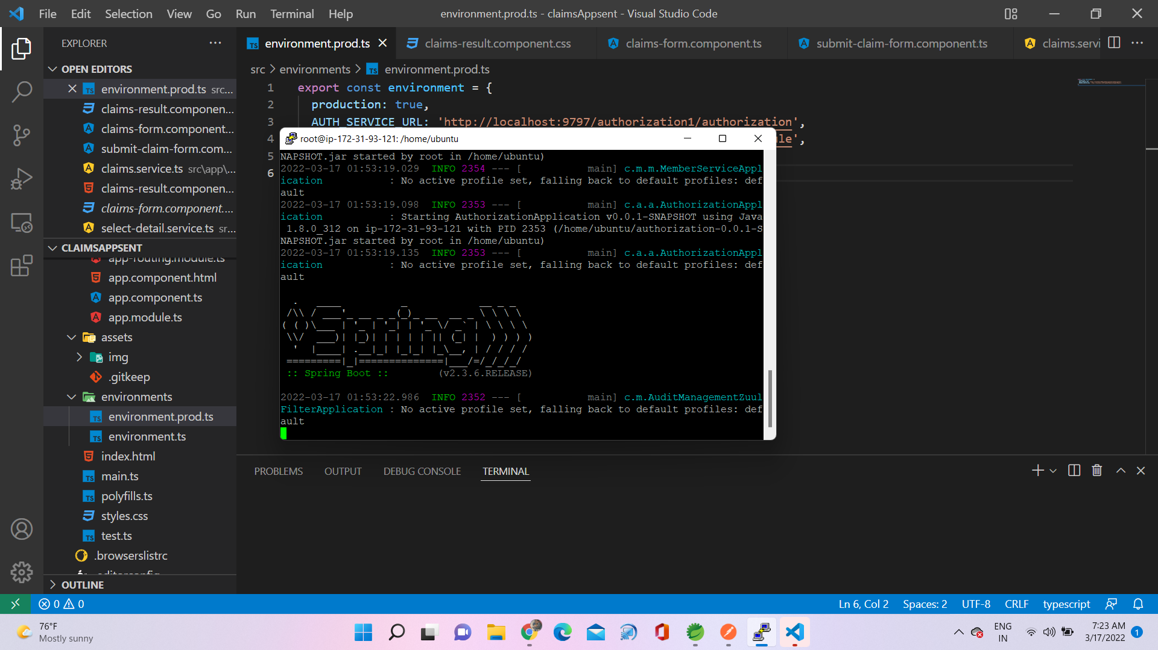

Slide 28
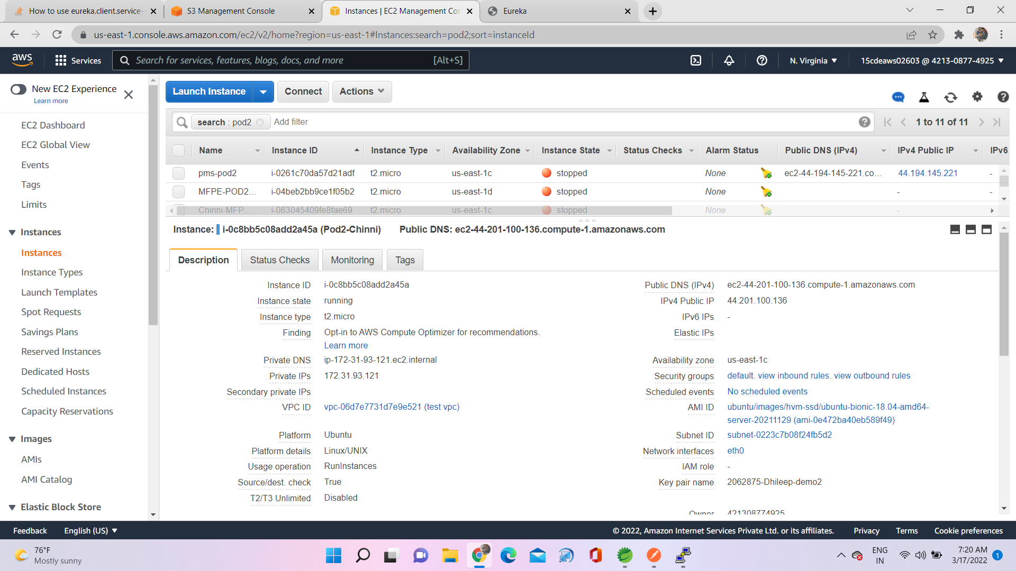

Slide 29
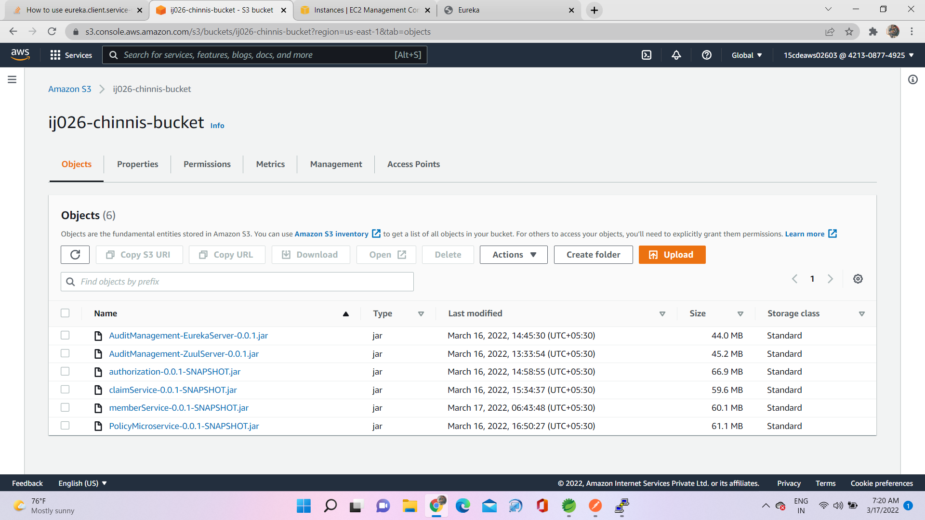

Slide 30
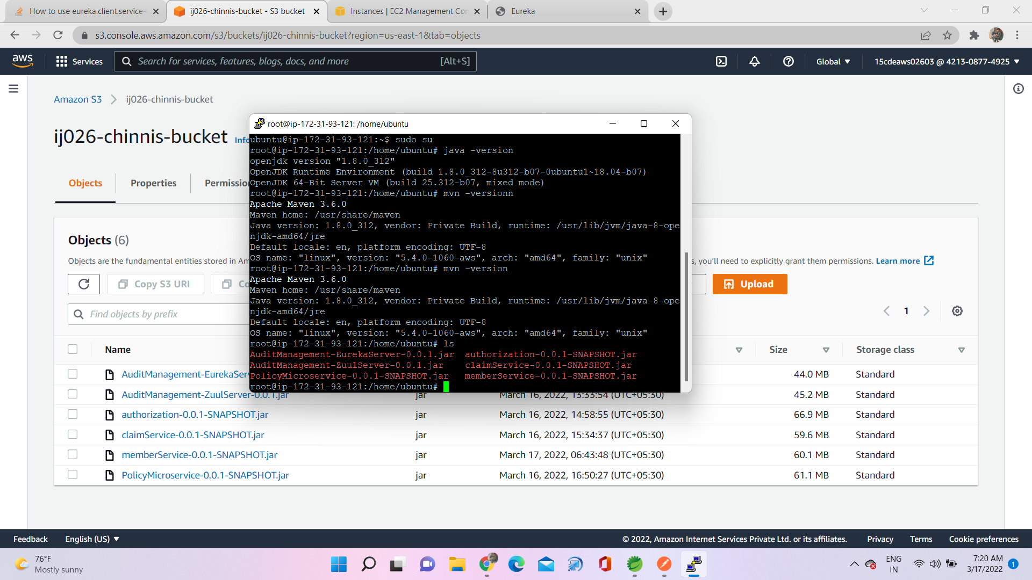

Slide 31
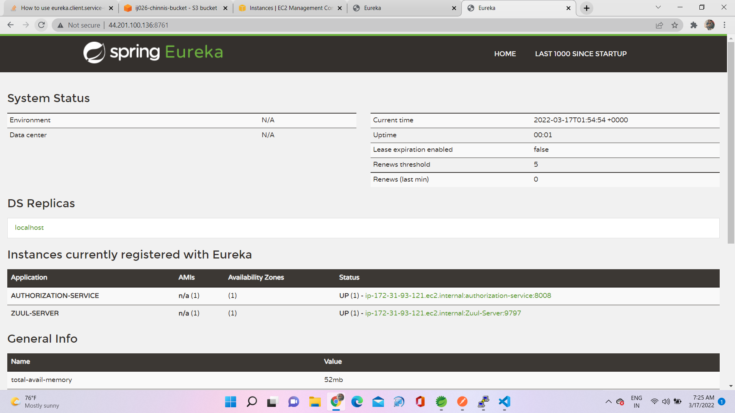

Slide 32
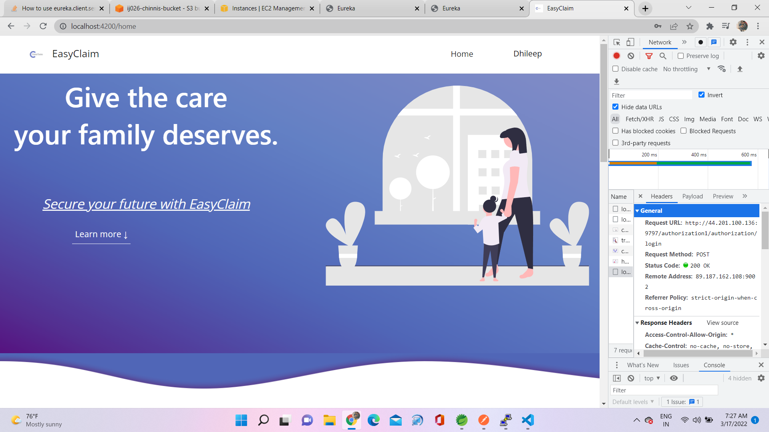

Slide 33

THANK YOU

